Slide 1
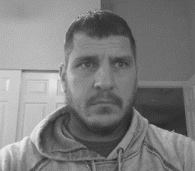
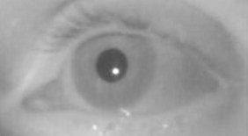
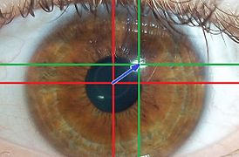
Gaze Data Flow
Non-Gaze Enabled Windows Apps
Custom UWP Apps
Hardware Support Application (HSA)
Camera
Fl
KB/Mouse Events
Gaze Moved (X/Y)
Gaze Events (Fixation, Dwell, etc.)
Images
Calibration Experience
Driver
Eye Control for Windows
Gaze Interaction UWP Library
Images
F
GazeInputSource UWP API
RequestCalibrationAsync()
Firmware HID Support
eyegaze:calibrate
Custom API
X/Y in HID Packets
Fl
X/Y Coordinates
F
GazeDevice
GazeHID Driver
X/Y in HID Packets
Microsoft Windows
Note 1: Connection from HSA to Custom API and/or Driver not pictured to reduce visual clutter Note 2: Firmware HID support is ideal. The GazeHID drivers are meant to be a bridge to assist in adoption of the Eye Tracker HID standard.

Slide 2
Driver State Diagram
Note 1: This diagram represents an idealized flow for the driver. A state change from Ready to any other state may be necessary. For example, if a change to the primary monitor occurs it would be expected to transition from Ready to Screen Setup Needed. Note 2: The sample driver may not implement all these states at this time.
Driver Starts
Screen Setup Needed
Screen information supplied
User Calibration Needed
User begins Calibration or stored calibration
Hardware Support Application (HSA)
Configuring
User begins Calibration
Calibration Experience
Calibration Complete
RequestCalibrationAsync() calls eyegaze:calibrate protocol scheme
Ready

